Slide 1
Understanding image set classifiers for future evaluation of adversarial profiles to gain control of our own privacy.
Bachelor Thesis Artificial Intelligence, Stijn Boosman
stijn.boosman@student.ru.nl
Supervisors: Martha Larson Zhuoran Liu
Notes:
Hi everyone, welcome to my presentation about: Understanding image set classifiers for future evaluation of adversarial profiles to gain control of our own privacy.
Now, I know this title is quite a lot to unpack, which is why we will walk through it together during the course of this presentation and will hopefully leave you a little wiser at the end, additionally if you have questions please ask them at the end of the presentation.

Slide 2
Contents
Introduction
Research Question
Approach
Results
Closing Thoughts
Notes:
The outline will looks as follows: I will introduce the topic at hand, state and explain the research question, followed by how we went about trying to answer it; show some of our findings, and end with some of my closing thoughts.

Slide 3

Introduction
Social Media
Notes:
Every single day, people go onto social media and generate tons of data. Through fairly recent developments it has become possible to process and analyze this data using machine learning, which has been a catalyzer in the privacy debate that is bigger than ever before.

Slide 4
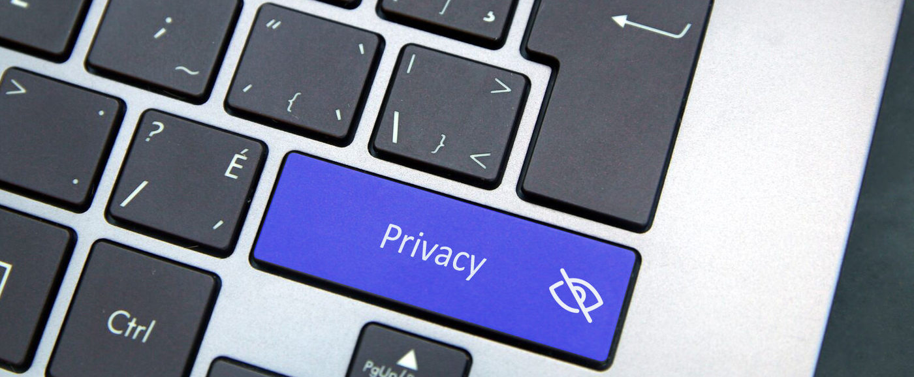
Introduction
Social Media
Privacy
Notes:
New research has now shockingly shown, that certain very private hidden pieces of information can be inferred from perfectly normal social media content using machine learning techniques.
That is, our personality, sexual identity, religion, political preference, ethnicity to just name a few, can be inferred from our profile pictures or likes. Something seemingly innocent. If these sensitive hidden pieces of information can be collected on a massive scale, with high accuracy, we believe this opens up an avenue for all kinds of potential problems. Apart from the fact, that people have a right to privacy which we want to maintain.
Information like this opens up the possibilities of exploitation of people with addiction, blackmail or persecution due to sexual preference or identity in some countries and micro-targeting for politics, furthering the divide we already see today.
So then, do we trust policy makers enough, to react fast to rapid technological change or trust companies that they will not use our data for their gain at our expense. We don’t think that’s enough, we want people to be able to govern and protect their own information in cyberspace if they choose so, without ideally having to stop using such services.
However, to do that we need to understand what we are going up against.

Slide 5
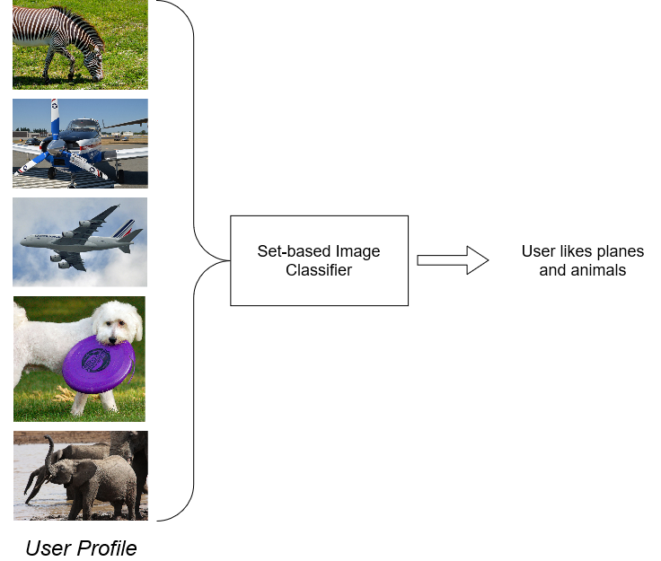
Introduction
Social Media
Privacy
Set-based image classifiers
Notes:
Let’s frame a scenario from an attacker’s perspective using a computer vision framework: A malicious actor wants to infer sensitive information from multiple pictures uploaded to a users social media account.
To achieve this, they will likely use a set-based image classifier. Set-based image classifiers, allow us to predict properties of multiple images at once. Rather than traditional, single image prediction, we can now incorporate much more information, namely all the pictures of a user’s profile and gain information based on that.
Now ultimately, one way to protect ourselves as users is to mislead such classifiers into making the wrong predictions, using adversarial examples. Yet we need to understand our adversary first, so we thought one way of doing so is to methodically investigate the reaction of classifiers to differing inputs, kind of like prodding and poking at it, to see where its weaknesses and strengths lie. With this in mind, let’s visit our research question.

Slide 6
Research Question:
How do different set-based image classifiers react to varying sets of images?
Notes:
The research question we formulated is:
So to summarize, our research aims to investigate differences and performances of a few different set-based image classifiers as well as provide an extensive, technical framework allowing for reproducible results. This is all in the hope to further the collective understanding of what adversaries we might be up against so we can defend ourselves. That way, we can empower users by giving them control of their own private information.

Slide 7
Sub-questions
What dimensions in sets of pictures, if any, are most relevant for different classifiers to base a prediction on?
How does the distribution of images play a role in set classification?
Notes:
To simplify our research question, we narrow it down to two main sub-questions which we empirically investigate.
What dimensions in sets of pictures, if any, are most relevant for different classifiers to base a prediction on?
How does the distribution of images play a role in set classification.

Slide 8
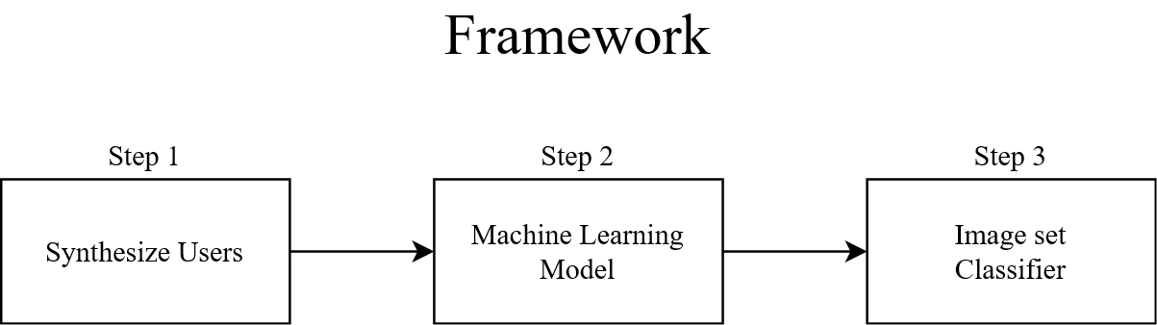
Approach
Notes:
The approach we took can be broadly summarized in three main steps. We synthesize users from a large dataset, put them through a machine learning model, and then classify accordingly. Let’s dissect these steps one by one.

Slide 9
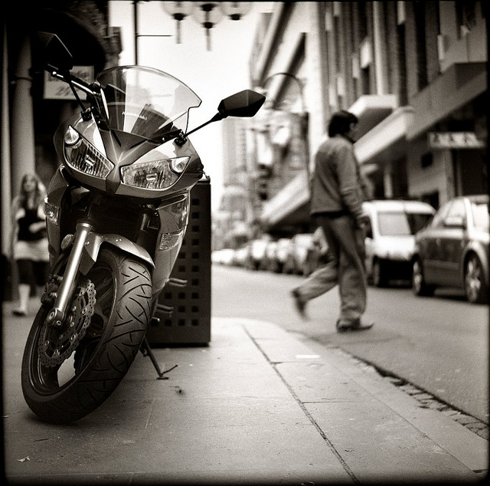
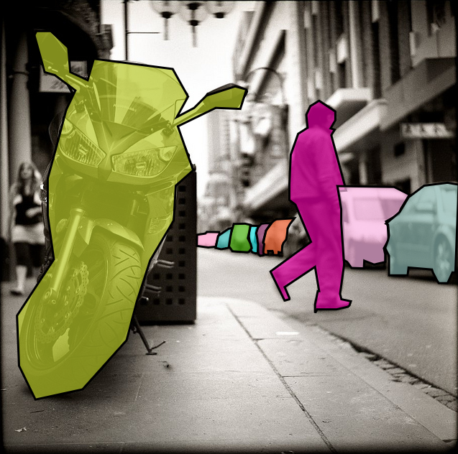
1. Synthesize Users
Object Detection rather than Image recognition
Notes:
Step 1
You might be asking yourself right now, why do we need to synthesize users? Why not use an existing dataset. The unfortunate fact is however that there are very little suitable dataset that exist as of yet, that fitted the requirements for our research.
While there are datasets that are collected and labelled on a user-level, there are none that incorporate object detection annotating, which is one of our key focuses.
Namely, in contrast to previous research on image-set classifiers, they almost exclusively use image recognition, so single labels per image.
However, we believe that images found in object detection tasks are much more representative of what could be posted on social media. Scenes of our daily lives are often much more complex, have multiple objects in images, sometimes only half in view and from lots of different angles. With image recognition datasets a lot of potential useful information is lost. From an attackers perspective, they would not want miss out on information that could lead to more accurate inferences about their target. If they can have a model trained on the most informative data available, they will do so.

Slide 10
1. Synthesize Users
Object Detection rather than Image recognition
COCO Dataset
Notes:
This is the reason why we chose the COCO Dataset by Microsoft, a gold standard benchmark for object detection. The 2017 version of the COCO dataset counts around 91 individual classes and it’s training set has roughly 118 thousand images. Almost every picture has multiple labelled objects in it, like the one here with an annotated motorcycle, person and a set of cars.
Despite these beautiful annotations, we are still left with the problem of labelling our users since we aren’t just looking at individual pictures but the set of pictures as a whole. The way we went about it is quite straightforward however:

Slide 11
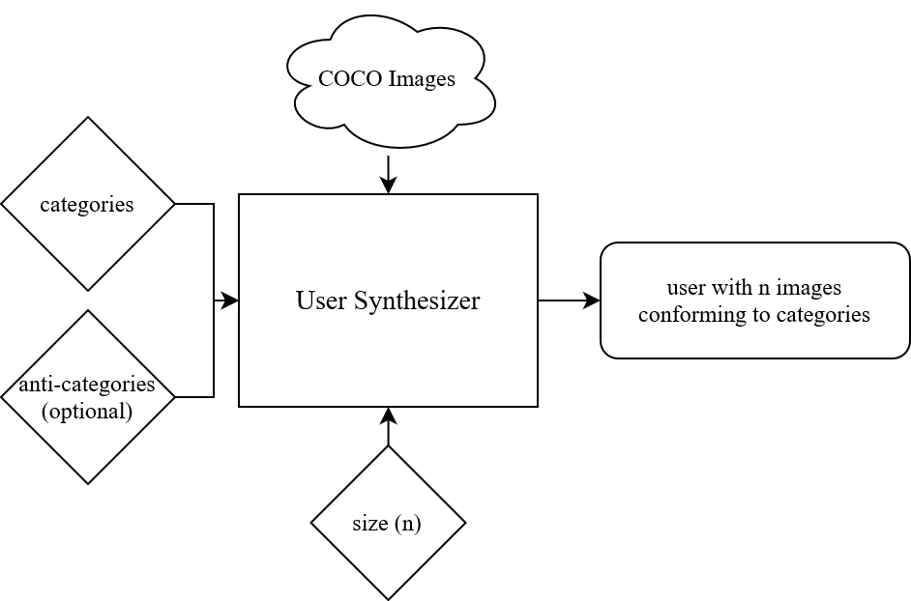
1. Synthesize Users
Object Detection rather than Image recognition
COCO Dataset
Super-category
Notes:
The COCO dataset comes with 12 handy super-categories, although our research only uses 11 of them. These can be seen as an hierarchical superclass. Take the super-category animal for example, it includes the normal classes dog, cat, zebra, elephant, giraffe and so on, but we collectively refer to them as ‘animal’.
We apply the simple rule that whatever super-category is represented by it’s sub-categories, we can use as potential labelling for that image. So an image with a dog and a car, will fall into the super-categories animal and vehicle.
Since we are working with sets of images of course, we mainly look at a user label, rather than individual image label.
Say we would like to compose a user that likes animals, and therefore label them with super-category animal.
That user then has n pictures that are randomly sampled from all images that fall into the super-category animal. Additionally, we can decide what categories we do not want represented in our sample space which will then be omitted entirely, we will call these anti-categories.

Slide 12
2. Machine Learning Model
Faster R-CNN Object detection model
Notes:
Step 2.
Initially we wanted to try predicting labels with a Faster R-CNN Object detection model, but this proved to be very difficult and tricky so we changed our approach.

Slide 13
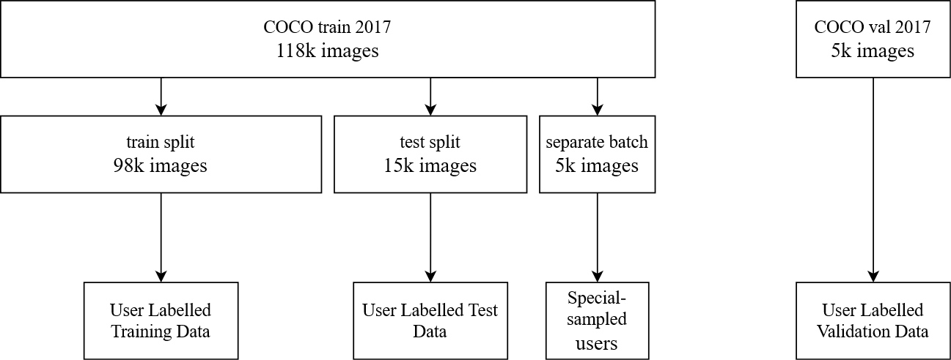
2. Machine Learning Model
Faster R-CNN Object detection model
VGG 16-layer Model
Notes:
We then explored an implementation with a VGG 16-layer model finetuned to predict two outputs. This reduces our problem of predicting to a pure binary aspect where one trained VGG network for vehicle will tell us if they predict a positive or negative match but it does also require us to train 11 different networks, one per super-category.
While there is no direct connection anymore between the individual object labels and locations when training the model, the important part is that the user labels are based on it’s object detection content. Therefore information is not lost, merely altered and made more digestible for the VGG network.
Every network was trained on 12.800 images for 24 epochs, with positive and negative labelled users being half and half respectively.
So after we have collected the individual image predictions for a user, it’s time to move on the last step of the framework.

Slide 14
3. Image set classifier
Two different techniques
Notes:
The third step, Image set classifiers.
Here we mainly looked at two different techniques and saw how they held up under varying conditions. However, the framework is set up in a way that any correct implementation of some different set-based classifier is supported. These two were just picked for the purpose of demonstrating and learning about their workings.

Slide 15
3. Image set classifier
Two different techniques
Majority Voting1
Weighted Feature Fusion1
[1] Z. Liu, Z. Zhao, M. Larson, Pivoting image-based profiles toward privacy Inhibiting malicious profiling with adversarial additions, (UMAP 2021), to appear.
Notes:
We will call these two techniques, Majority Voting and Weighted Feature Fusion. Their respective implementation is largely based on the way it is used in the privacy pivot paper but adapted for our use.

Slide 16
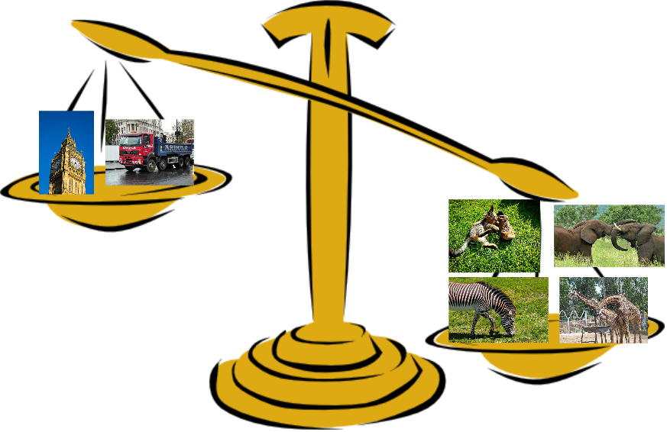
3. Image set classifier
Two different techniques
Majority Voting
Weighted Feature Fusion
Notes:
Majority Voting is a very straight forward way to decide which super-category a user might belong to. By passing all the images of a user through all the networks, we get multiple predictions per super-category.
These predictions are either positive or negative.
If Majority voting sees the category: ‘animal true’ in 12 out of the 20 pictures, in other words the majority, it will output positive for animal for the entire set. If it is only 8 out of 20, it’ll be negative respectively.

Slide 17
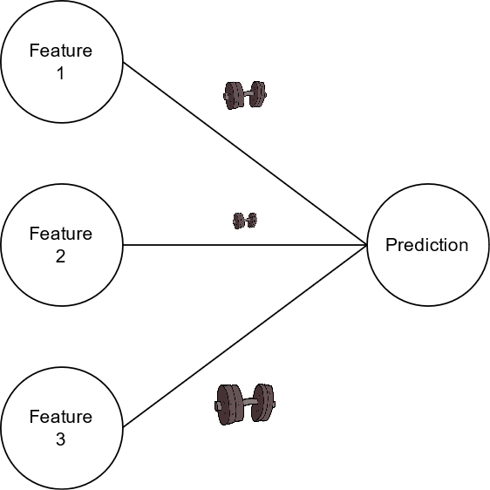
3. Image set classifier
Two different techniques
Majority Voting
Weighted Feature Fusion
Notes:
Weighted Feature Fusion is slightly more complex. It computes a discriminability value which will indicate how “weighted” certain features in a picture are. So some indications in pictures will be more informative than others.
Think of this simple example. If we encounter someone smoking a cigarette in just one or two pictures among their profile, we as a human observer probably think that person is a smoker no matter the content of their other pictures.
Yet majority voting will not interpret it as so when included with for example 5 or more other pictures, as the majority are non-smoking related.
Weighted Feature Fusion on the other hand might have a better chance at this as it treats different objects with varying importances.

Slide 18
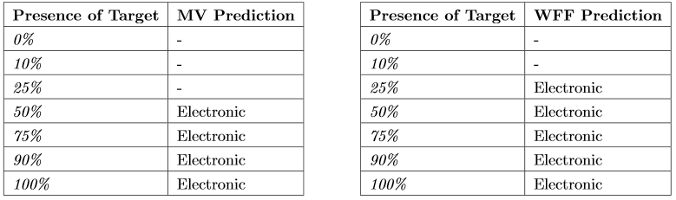
Results
Table 1.1: Comparison of MV and WFF when faced with varying levels of target class Electronic
Notes:
We unfortunately do not have the time to go into a lot of detail with our results, but this excerpt of some them show how we control and change the distributional content within a set.
You see, what we did here is applied a sort of ‘data recipe’ where we create multiple users that vary slightly in the presence of a target category. Here we define our target category as Electronic. One profile includes 0 out of 20 pictures where our target occurs (0 percent), another only 2, the next only a quarter, a half and so on. This allows us to clearly see the difference between WFF and MV, where WFF seems to pick up a lot quicker that there is sufficient evidence in the set of pictures to recognize the target class.
Now for the sake of clarity other classes that are recognized alongside our target are left out here, but generally speaking the set-based classifiers do not only predict a single class. Considering the fact that we use object detection content, this is not too surprising as classes often co-exist, and there is sometimes strong correlation between two classes in appearing together in scenes. Think of vehicle and outside or kitchen and food, it’s not surprising to see pictures with both contents in it appearing, so this opens up possibility for some future research and analysis.

Slide 19
Closing Thoughts
!
Notes:
So in conclusion, while this research does unfortunately not immediately solve the problem of privacy protection in cyber-space, it hopefully lays some small stepping stones for future developments in the field, and allows the topic to mature further. While data used is largely synthetic, if effective adversarial examples can be crafted for it, we think it will translate well to real-life datasets that are likely even harder to fit.
It opens up the dialogue about research into the topic of creating utilities we can utilize ourselves to stay safe online, and help in conveying the need of good datasets for set-based training so models can be created that closer predict reality. As with any large technological strides, machine learning can be a two edged sword. If used for good, it can be amazing, but when used for bad, we will need methods to protect ourselves, especially online in the age of information.
Thank you for listening.

Slide 20
Questions
?

Slide 21
References
Code (to appear) : https://github.com/HcKide/ImageSetClassificationFramework
https://www.intouchcrm.com/wp-content/uploads/2018/01/Success-in-Social-Media-April-7-2016.jpg
https://www.freepress.net/sites/default/files/privacy.jpeg
http://www.clker.com/cliparts/S/Q/v/V/q/s/unbalanced-scale-right-hi.png
Zhuoran Liu, Zhengyu Zhao and Martha Larson, Pivoting image-based profiles to-ward privacy: Inhibiting malicious profiling with adversarial additions, 29th Conference on User Modelling, Adaptation and Personalization (UMAP 2021), to appear, 2021.

